Slide 1
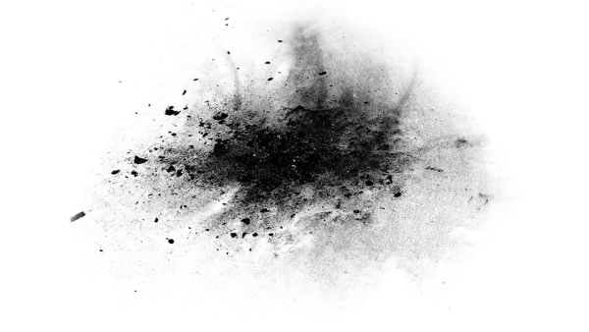

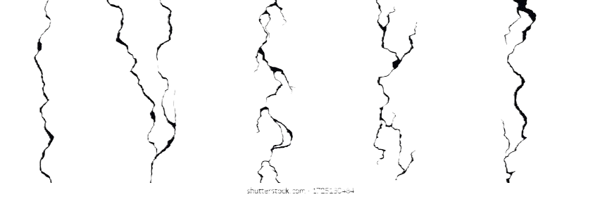

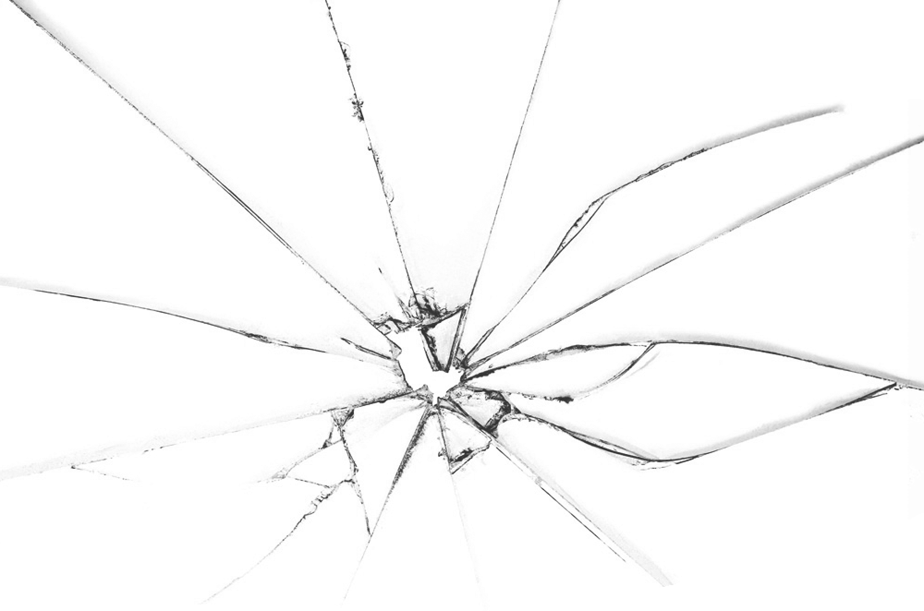
Frames of Belief

Slide 2

What is Ideology in Art
This Exhibit explores how ideologies whether political, cultural, social or personal shape our values or perceptions. Through these next few artworks subtle ways of influence will be revealed. The goal of this exhibit is to spark curiosity and encourage viewers to engage more consciously with such messages

Slide 3

The Theme of Resistance and Revolution
Ideology in art serves as a powerful tool for fostering resistance and revolution.
Which is often shown through provocative imagery and symbolism that tend to challenge traditional structures and inspire people to think critically. The poststructuralist theory is the way of thinking that challenges the idea that truth and knowledge are fixed. This also seems to align with Claire Bishop's research which states "Such work seems to derive from a creative misreading of poststructuralist theory; rather than the interpretation of a work of art being open to continual reassessment, the work of art itself is argued to be in perpetual flux." (p.52 2004). This interpretive ability not only challenges norms but also empowers viewers to reconsider their circumstances.

Slide 4
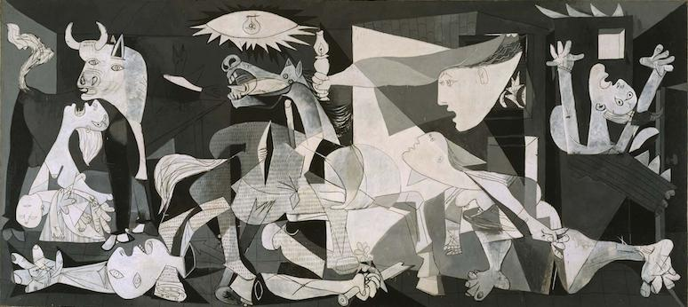
Cubism (anti-war)
Pablo Picasso
Guernica
1937
Notes:
https://www.britannica.com/topic/Guernica-by-Picasso
I believe that the work connects the Broad theme of Ideology in art but a subsection representing a Revolution and Resistance Ideology. This is in a sense that it condemns the cost of war reflecting what it does to the people. Which thus creates a sense of resistance to the war.
This work was created after the bombing of the city of Guernica as a way to condemn the brutal tactics of Gen. The request for this artwork was before the bombing, however the bombing pushed Picasso to create this artwork.
My parenthetical citation that helped me was "Oh yes, I found that in the newspaper, and it was my way of showing I was against the war" (Bootle of Suze 1912) as well as "On the other hand, they lead to arrested development of academic technique, deformation, ugliness, savagery, madness, and social degeneracy." (Note: The next couple of slides will be done the same way if they were supposed to be incorporated into each of the statements I will make that correction afterwards.)

Slide 5
Picasso's Guernica was created in 1937 in direct retaliation of the bombing of Guernica during the Spanish Civil War.
The bombing was targeted towards civilians deliberately on Market day when it would be the busiest
Notes:
General Background information
The piece was created as stated by McQuillan "The Spanish Republican government asked Picasso to paint a mural" the result of this was Guernica which was created just 5 days after its bombing ( 5 2024). The artwork was not only an individual project but was helped by a person named Dora Maar.

Slide 6
Fragmented figures of distorted limbs and people crying pull you int the destruction that is created
The use of grayscale coloring gives a somber feeling which amplifies the emotions expressed
From screaming faces to dismembered bodies, these small details accentuate the raw emotion that comes from War
Notes:
Artistic Background Information
The composition gestured to politicized imagery as it created a strong anti-fascist feeling among many Europeans (Irace 2 2003).
Cubism "exaggerated changes of viewpoint applied to the figures. . ." this left room for people's own interpretation of what was happening in the painting (Green 3 2003).

Slide 7
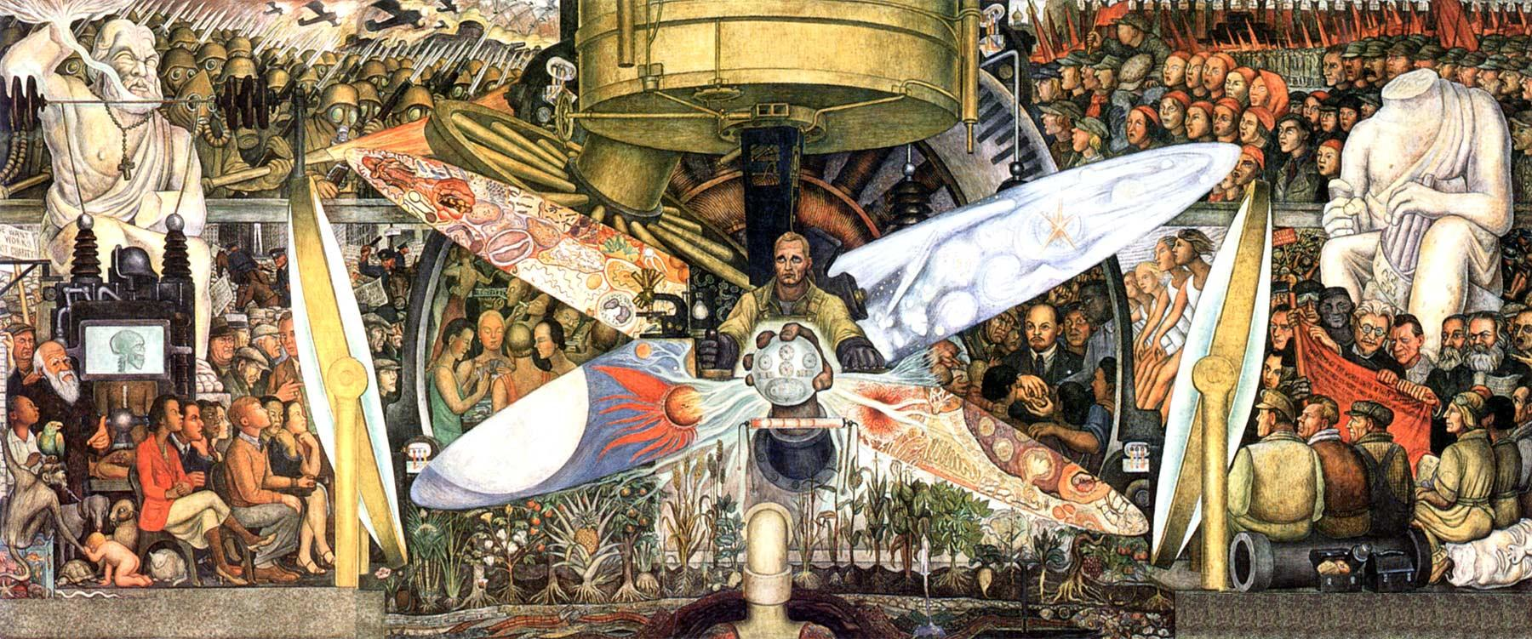
Social Realism (Economic Systems)
Diego Rivera
Man at the Crossroads
1934
Notes:
https://www.diegorivera.org/man-at-the-crossroads.jsp
This artwork connects to the Revolution and resistance because of the man at the middle of the mural who is see the revolutionary vision for between Capitalism and Socialism. It also expresses a sort o conflict between the two
This shows more of the theme because of its original destruction during the commission at Rockefeller because of its socialist ideals which were seen as a form of resistance.
I had to use a different resource here is the MLA citation Panaram, Sasha Ann. “El/Oil Dorado: Art and Activism in Guyana.” Journal of West Indian Literature, vol. 32, no. 1, Nov. 2023, pp. 97–116. EBSCOhost, research.ebsco.com/linkprocessor/plink?id=047652ef-7f29-3336-8ef5-8a039c1a1fa7.
The citation I used was the ". . . how artists can raise awareness about environmental degradation and advocate of principled practices, . . . draws on a range of creative practices to critique Western capitalist expansion and explotation while raising the important questions about who benefits from foreign investment" (Panaram 2023). I chose this because it deals with the impact of expansion of capitalism which is something that Man at the Crossroads was expressing.
(Background Information/Why it's Important)

Slide 8
Commissioned for Rockefeller Center but didn't go as planned
The piece depicted Lenin, which stirred a debate between capitalism and socialism that didn't sit well with the Rockefellers who had very capitalistic views
Rockefellers thought this was a challenge/Resistance towards capitalism, so they decided to destroy them
Notes:
As previously stated he began his work for the Radio Corporation of America which was in the Rockefeller Center, New York, but was prevented from finishing the painting because it contained Lenin (O'Connor 1 2003).
As stated a lot of his paintings contained economic ideologies as stated by O'Connor "The artist devised a programme of 41 fresco panels in which socialist revolution parallels the evolution of nature" this was only one of many works that added to his catalog of art like this (2 2003).

Slide 9
The artist decided to create a Mural which allows for public access since it becomes such a big creation
Symbolism plays a central role notice Lenin surrounded by the subtle hints of communist ideals
The packed composition mirrors the complexity of these ideologies.
At the heart of it all lies the man, who represents you, the mural then asks you to not only look, but to choose between the two
Notes:
The mural style also had a create impact on the people as "It had a worldwide influence on public mural paintings . . ." and most of his works were from easel works, drawing and prints, but his murals is what he became most well known for since he was so radically different from his colleagues (O'Connor 2 2003).

Slide 10
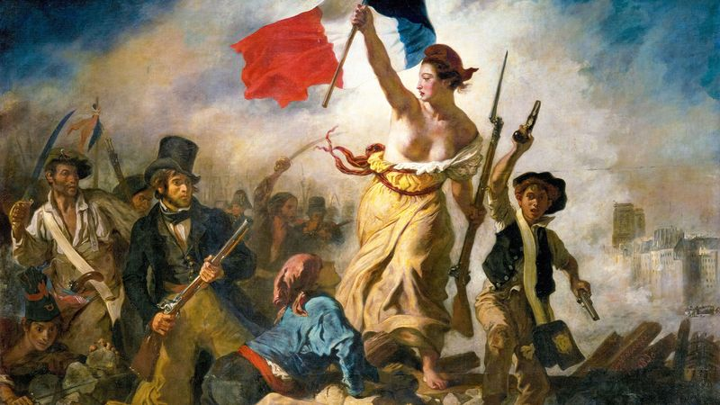
Romanticism (Culture revolution)
Eugene Delacroix
Liberty Leading the People
1830
Notes:
https://en.wikipedia.org/wiki/Liberty_Leading_the_People
This connects to the larger theme in a sense of actually being the result of an actual Revolution, the french revolution, and in this piece it depicted people of all classes and age uniting and charging forward with "Lady Liberty".
This gives more insight for the theme because of its actual use which was to show heroism in resistance and create a unification for everyone regardless of class in the hopes of change.
The ". . . criteria we should use to evaluate open ended participatory art works are not just aesthetic, but political and even ethical: we must judge the 'relations' that are produced by relation art works" (Bishop 2004). In this case the relation that was produced with the relation to this artwork was the unification of the people regardless of social status.

Slide 11
This painting captures the spirit of revolution and change from the July Revolution in France
It celebrates the people's fight to overthrow monarchy and move towards democracy
At the time of its creation, the subject matter at hand was controversial as it challenged and celebrated the resistance to tyranny
Today it stands as a powerful symbol of democracy and an ideal for revolution
Notes:
As stated this art piece is considered a staple in revolutionary ideology as stated by the History Painting "it is considered one of the most potent French national images" since It created such a unification between different social classes (1 2003).
This composition was directly influenced by "a scene witnessed by Delacroix near the Pont d' Arcole in Paris" all of which were during the days of the July Monarchy as a heroic emblem of struggle (Harrison 1 2003).

Slide 12
The composition is a striking example of romanticism as it emphasizes the individual heroism through the symbolic figure of Lady Liberty
However, Lady Liberty is not an actual person but an allegory, a symbolic figure leading the charge.
The people shown in the pictures are symbolic of the social classes from workers, children, to the elites
The composition of the piece creates a commanding presences from the embodiment of freedom and leadership (Lady Liberty) which they all come together to fight
Notes:
1. Romanticism explored the "optical effects and for its symbolic associations" which could be seen clearly in both Liberty and the people surrounding her (Vaught 3 2003).
2. The painting did indeed do its job as stated by Gaynor who feared of the effects from the painting "he thought that [the painting] might provoke insurrection if exhibited at the Exposition Univereselle of 1855"​ (1 2003).

Slide 13
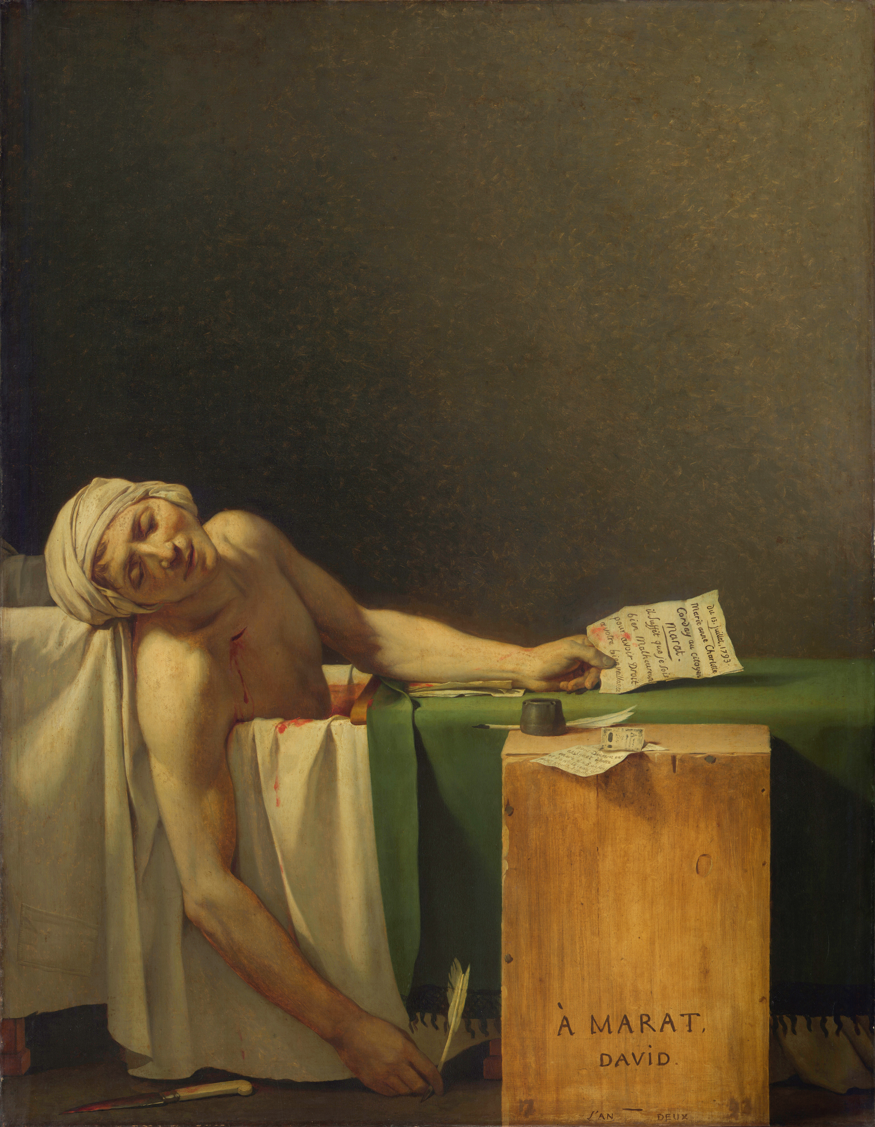
Neoclassism
Jacques-louis David
Death of Marat
1793
Notes:
https://en.wikipedia.org/wiki/The_Death_of_Marat\
This artwork connects to the theme of Revolution and resistance just like how Liberty leading the people did in a sense of garnering unity and loyalty to the cause.
This work was used as a form of revolutionary propaganda, which served as a symbol of resistance. This is because Marat became a portrayal of his image as a martyr and reinforced his ideals by underscoring the movements commitment to continue to fight
"For key artists in these movements, anarchist aesthetics and a related 'politics of form' played a crucial roles in the development of their modernist art in Avant-guerre France, but its significance was first suppressed and then forgotten."
"Political satire continued throughout the nineteenth century in France and played an important role in fin de siecle culture, continuing, directly into the avant-guerre period." (Leighten 2013). This was used because of its implication that even after the french revolution there was still art that was created in order to challenge the status quo of the "new france".

Slide 14
Created during the French revolution, the art piece reflects a very pivotal moment in history.
Jacques-Lous David was once a court painter for royalty but later turned against the monarchy aligning with the revolutionaries.
The character depicts Jean-Paul Marat a radical leader who was assassinated by conservative Charlotte Corday
The assassination had a opposite effect of breaking the radicals' resolve it strengthened their determination to fight for their cause
Notes:
One of the key elements of this painting was the lack of presence of the person Charlotte Corday who was the murderer of Marat. The exclusion of her is a drastic shift from the previous artwork where the centerpiece was a woman. However, Kadish argues that the way Marat is portrayed represents femininity through its qualities present (204 2009).

Slide 15
This paining uses minimalist elements to draw all attention to Marat, a fragile bodied man since he had a skin disease which kept him confined to a medicinal bath.
The dramatic lighting casts him as a martyr (someone who dies for their cause)
Small but important details such as the letter in his hand which symbolized Marats dedication to petitions and grievances of the people
Notes:
Neo-Classicism was created by him a style in which "austere and ethical painting that perfectly captured the moral climate" One of the obvious examples was the identification of Marat as seen in the bathtub (Lee 1 2003).
The dramatic lighting was inspiration from the actual lighting in the "church of the Cro

Slide 16
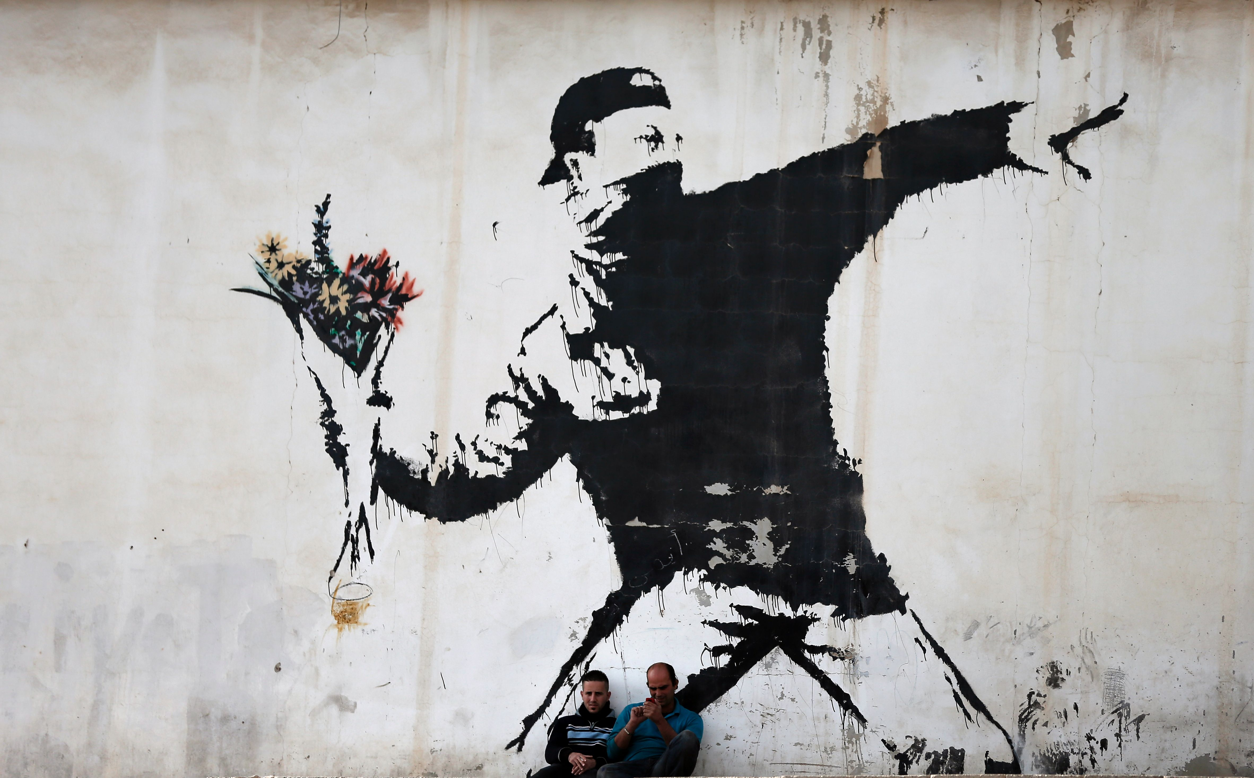
Symbolism Graffiti Art (Anti-Violence)
Banksy
Love is in the Air (Flower Thrower)
2003
Notes:
https://en.wikipedia.org/wiki/Flower_Thrower
This artwork connects to the theme of Revolution and Resistance because of its use of a protester however the only difference is the fact that the protester has a bouquet of flowers rather than a weapon.
The context of the art is to try and revolutionize the type of protesting that is done against the face of oppression. This is shown with the replacement of a weapon to a flower which symbolizes love and peace as the weapon against oppression.
"People can protest peacefully AND work together to stop Covid . . ." This was talking about Covid and the George Floyd's death and the protest that occurred from it. However, the explicit statement of saying things could have been protested peacefully explains this picture almost perfectly. Which tries to promote peaceful protesting rather than causing anarchy. "The most effective propaganda relies on framing rather than on falsehood." This is important to note because lots of art work tends to lie in order to make a side seem worse than the other. However, with the correct use of truth and shaping the way it seems art can be used as a way to prevent such thoughts and drive a stronger emotional attachment then lying and making things up. (Staal 52 2019).

Slide 17
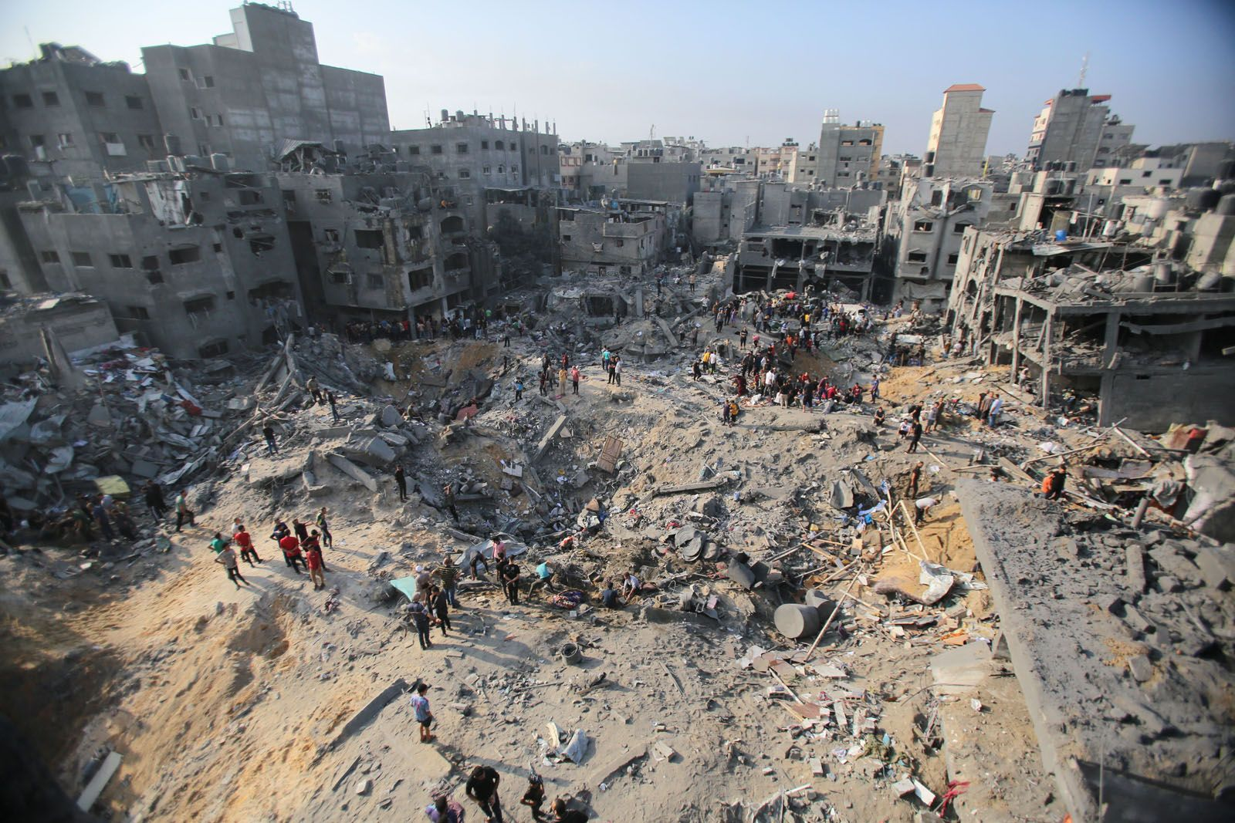
This piece emerged during the intense conflict of the Second Intifada (2000-2005), a violent struggle between Israeli forces and Palestinian groups.
This composition stands out because of its depiction of a neutral protester, offering a no biased perspective on the conflict.
The conflict took place because of the struggle over the Israeli occupation of Palestinian territories and the failure of peace processes
The piece also captures the tension and
toll of conflict that continues to this day
Notes:
It was painted on the West Bank Wall in Jerusalem, which was a place that was heavily conflicted place because it was built by the Israeli forces for the Second intifada. However, the creation of this wall created greater criticism for the Israeli forces
Another thing that can be seen on the news is the fact that there is still conflict between the two to this day, so graffiti and art like this continues to be spread for the hope of possible resolution or change for the future.

Slide 18
This piece captures one of Banksy's iconic techniques which is using a stencil which allowed for a quick and repeatable style to be shown everywhere
The use of B&W coloring is used to contrast it with the colorful flowers that are being held
The use of a juxtaposition is seen with the act of throwing a weapon is replaced with a bouquet of flowers, which challenge violent protest tactics and call for peaceful solutions from both sides
Notes:
As stated Banksy is known for his "Stenciled graffiti" this was not his only work that had to do with some kind of controversial violence other works such as his graffiti texts such as his common phrases like "'designated riot area'" seem to be prominent in his works (Mix 1 2011).
Another important fact is that Banksy tends to use walls or buildings near the said controversial cites such as the West Bank Wall which was created mainly to protect against future attacks which became the Second Infintada.
Also some of Banksy theme's tend to involve conceptual contrasts such as the flower being a replacement of what would be a violent object in the hands of the protester which is used to create a disruption in the viewers thought process as to why its like that (Mix 1 2011).

Slide 19
Works Cited
Bishop, Claire. “Antagonism and Relational Aesthetics.” October, vol. 110, Oct. 2004, pp. 51–79. EBSCOhost, research.ebsco.com/linkprocessor/plink?id=57c4291d-3644-3112-affd-78058fe3e6e4.
Doris Y. Kadish (1990) Inclusion and Exclusion of Femininity in David's Marat assassiné , Rethinking Marxism, 3:3-4, 202-217, DOI: 10.1080/08935699008657937
Gaynor, Suzanne. "Nieuwerkerke, (Alfred-Emilien O’Hara), Comte de." Grove Art Online. 2003. Oxford University Press. Date of access 25 Nov. 2024, <https://www.oxfordartonline.com/groveart/view/10.1093/gao/9781884446054.001.0001/oao-9781884446054-e-7000062458>
Green, Christopher, and John Musgrove. "Cubism." Grove Art Online. 2003. Oxford University Press. Date of access 25 Nov. 2024, <https://www.oxfordartonline.com/groveart/view/10.1093/gao/9781884446054.001.0001/oao-9781884446054-e-7000020539>
Harrison, Colin. "Delacroix, (Ferdinand-)Eugène(-Victor)." Grove Art Online. 2003. Oxford University Press. Date of access 25 Nov. 2024, <https://www.oxfordartonline.com/groveart/view/10.1093/gao/9781884446054.001.0001/oao-9781884446054-e-7000021888>
"History painting." Grove Art Online. 2003. Oxford University Press. Date of access 25 Nov. 2024, <https://www.oxfordartonline.com/groveart/view/10.1093/gao/9781884446054.001.0001/oao-9781884446054-e-7000038306>

Slide 20
Works Cited
Irace, Fulvio. "Fascism." Grove Art Online. 2003. Oxford University Press. Date of access 25 Nov. 2024, <https://www.oxfordartonline.com/groveart/view/10.1093/gao/9781884446054.001.0001/oao-9781884446054-e-7000027618>
Lee, Simon. "David, Jacques-Louis." Grove Art Online. 2003. Oxford University Press. Date of access 25 Nov. 2024, <https://www.oxfordartonline.com/groveart/view/10.1093/gao/9781884446054.001.0001/oao-9781884446054-e-7000021541>
Leighten, Patricia Dee. The Liberation of Painting : Modernism and Anarchism in Avant-Guerre Paris. University of Chicago Press, 2013, https://doi.org/10.7208/9780226002422.
McQuillan, Melissa. "Picasso [Ruiz Picasso], Pablo." Grove Art Online. 2003. Oxford University Press. Date of access 25 Nov. 2024, <https://www.oxfordartonline.com/groveart/view/10.1093/gao/9781884446054.001.0001/oao-9781884446054-e-7000067316>
Mix, Elizabeth K. "Banksy." Grove Art Online. June 02, 2011. Oxford University Press. Date of access 25 Nov. 2024, <https://www.oxfordartonline.com/groveart/view/10.1093/gao/9781884446054.001.0001/oao-9781884446054-e-7002093873>
O’Connor, Francis V. "Rivera (y Barrientos Acosta y Rodríguez), Diego." Grove Art Online. 2003. Oxford University Press. Date of access 25 Nov. 2024, <https://www.oxfordartonline.com/groveart/view/10.1093/gao/9781884446054.001.0001/oao-9781884446054-e-7000072302>
Staal, Jonas. Propaganda Art in the 21st Century, MIT Press, 2019. ProQuest Ebook Central, https://ebookcentral.proquest.com/lib/valdosta/detail.action?docID=5894158.
Vaughan, William. "Romanticism." Grove Art Online. 2003. Oxford University Press. Date of access 25 Nov. 2024, <https://www.oxfordartonline.com/groveart/view/10.1093/gao/9781884446054.001.0001/oao-9781884446054-e-7000073207>

