Slide 1

Independent Contractor Process
Steps to follow

Slide 2
Sample scenario
In this scenario, you are George Washington and you work for the VSU department “GOVT.” You need to get an independent contractor (Abraham Lincoln) approved to be a guest lecturer as part of your department’s yearly lecture series “How to Fill Out Forms.” Abraham will be speaking on 12/02/2022. You are filling out the forms on 11/01/2022 in order to have time for processing (the forms must be submitted a minimum of 30 days before the service date). All the sections that you fill out will be highlighted on the sample forms so you can see where you would enter the information.

Slide 3
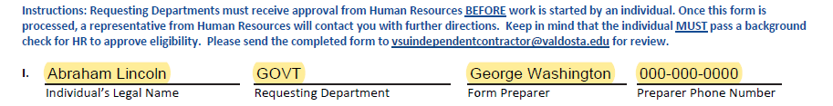
Determination of status form (DOS)
Section 1
List the independent contractor, the requesting department, and the form preparer along with their phone number
Put the LEGAL NAME so it will match the vendor invite/background check if needed.

Slide 4
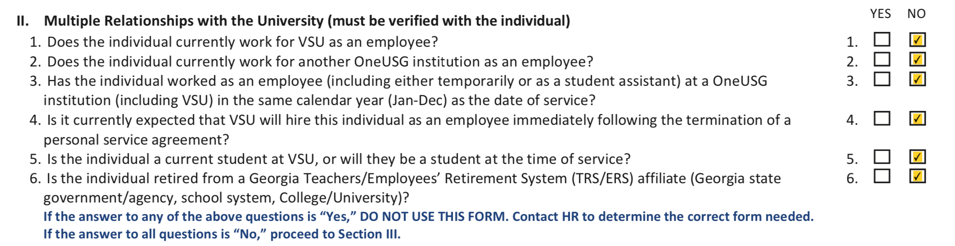
Section 2 of the DOS form
Fill out Abraham’s relationship status with VSU/OneUSG:
If Abraham falls under any of these criteria check yes for the box in section 2:
If he is currently working for VSU/OneUSG
If he has worked as an employee for VSU/OneUSG in the same calendar year as the date of service of this contract
If he will be hired by VSU after his contract is up
If he is retired from TRS/ERS GA affiliate
If he is a student or will be a student at the time of service
Abraham is a self-employed freelance lecturer who has never worked for a GA retirement affiliate and is not a student so you would check No for all boxes

Slide 5
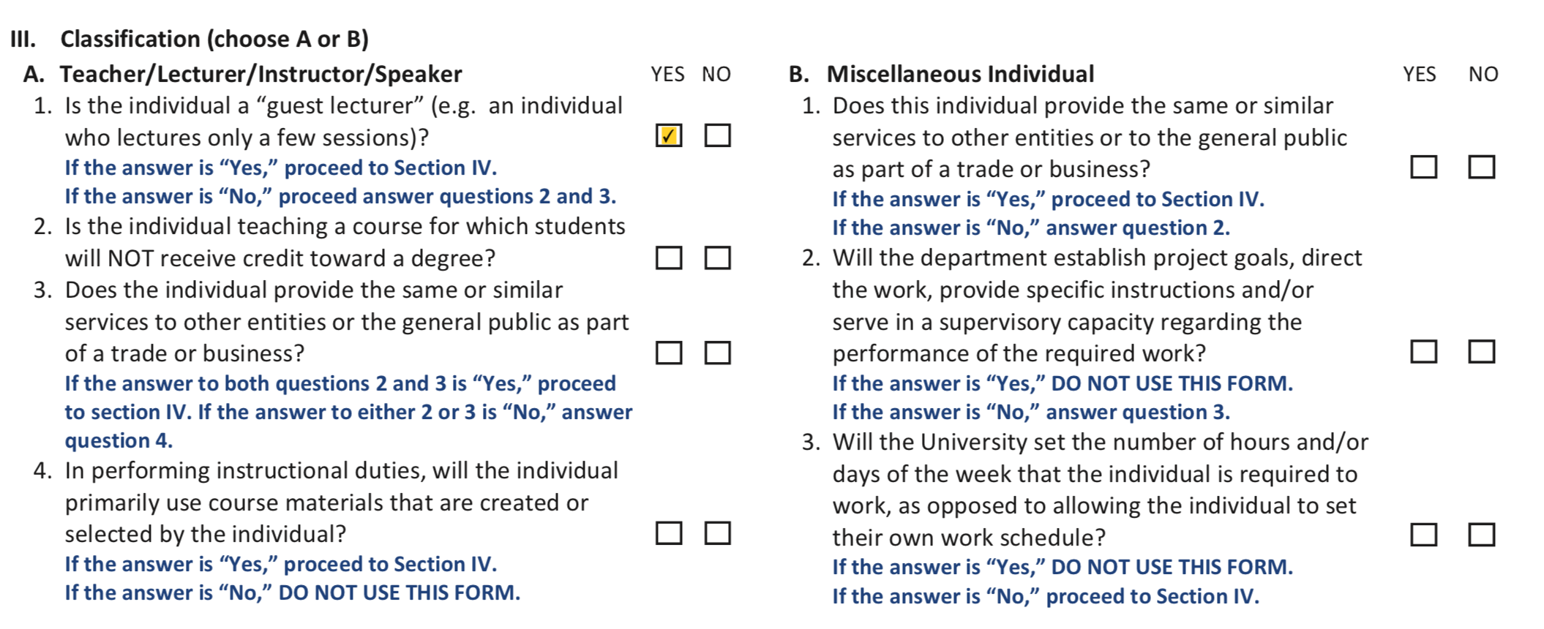
Section 3 of the DOS Form
Determine Abraham’s classification. He is a freelance guest lecturer, so select only Section A Teacher/Lecturer/Instructor/Speaker.
Check Yes for question 1 since he only lectures for one/a few sessions.
Skip all the other questions in Section 3 and leave them blank since they do not apply (and skip Section B as well).

Slide 6

Section 4 of the dos form
Answer if this is a Position of Trust (which is described on the back of the DOS form).
This is not a Position of Trust, so check No for this question.
There are no minors involved in the yearly lecture series which is a public event, so you do not contact Minors on Campus.

Slide 7
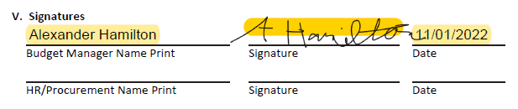
Section 5 of the Dos Form
Have your Budget Manager (Alexander Hamilton) approve and sign the form before submitting it to HR.
Leave the bottom boxes blank for HR to process/sign.

Slide 8
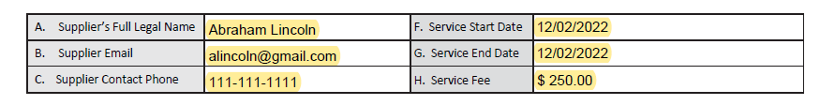
Monetary service agreement form
If you have any questions on how to fill out the MSA form, please contact Procurement at 229-333-5708 since this is their form. The MSA form must be filled out before it is sent to HR.
Fill out the top section with the supplier’s (Abraham Lincoln) information, the service dates, and the service fee. The e-mail on this form is the e-mail used for the background check if needed, so please make sure it is correct. Abraham will only be working one day (02/02/2022), and he will be paid one set fee ($250) for the day

Slide 9
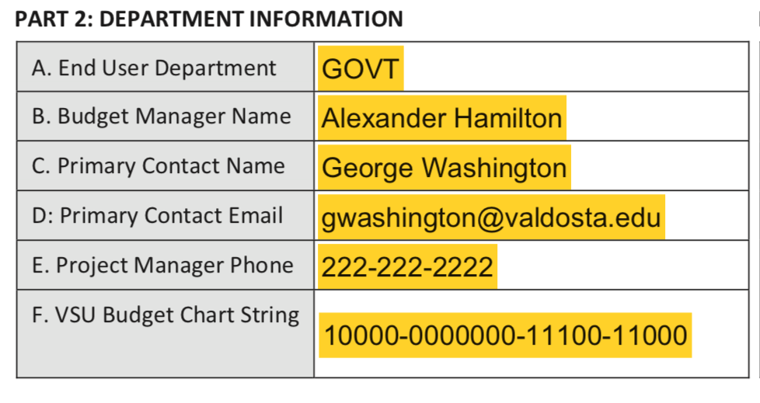
Part 2 of the MSA form
Fill in your department’s (GOVT) information. The primary contact person is the person who filled out the form and is contracting Abraham (George Washington). When filling out the form electronically you must have auto resize text activated or the form will cut off your budget string and Procurement will not be able to read it.
In Adobe, this feature is under Tools→ Forms & Signatures→ Prepare Form. Then right-click the text field and select Properties→ Appearance→ Font Size→ Auto. This only has to be done once and then this form will always auto-size whenever you download it again in the future.

Slide 10
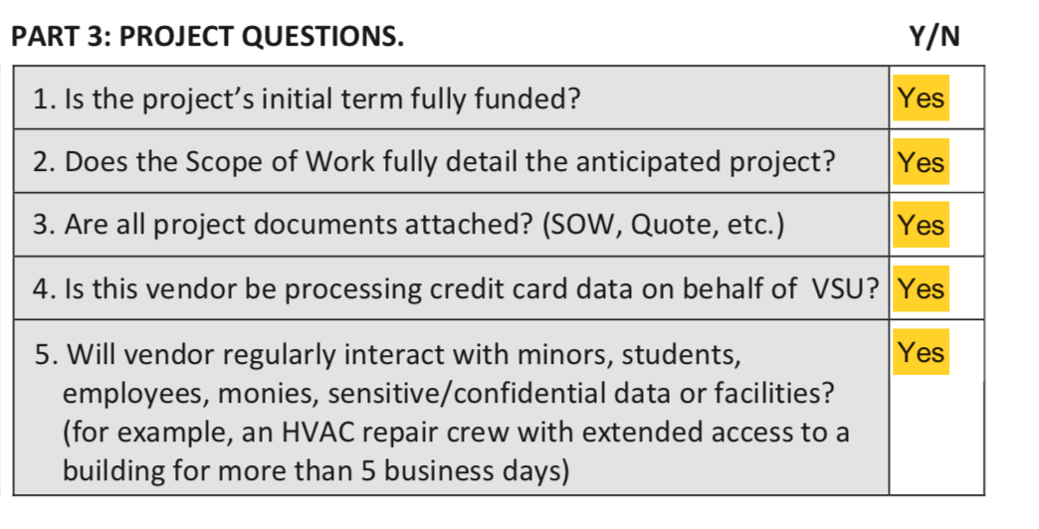
Part 3 of the MSA Form
Answer the project questions:
The Budget Manager has approved everything
You know what Abraham will be doing
There are no additional documents
Abraham will be interacting with employees because he will be answering questions, teaching, role playing, etc.
Therefore, you select Yes for all five questions in Part 3.

Slide 11
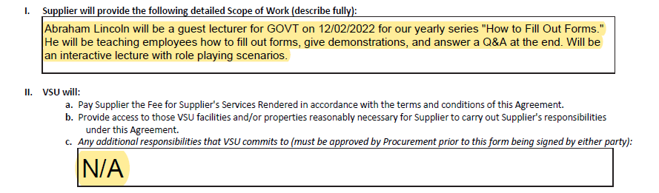
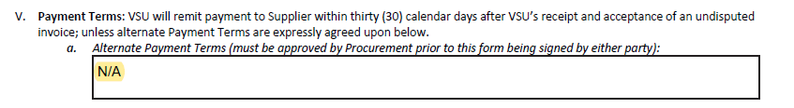
Part 4 of the MSA form
Fill in sub-sections I, II, and V which pertain to the Scope of Work and Payment Terms. You will fill in that Abraham is a guest lecturer and detail his job duties. There is no additional payment information, so you fill in N/A for the remaining sections.

Slide 12
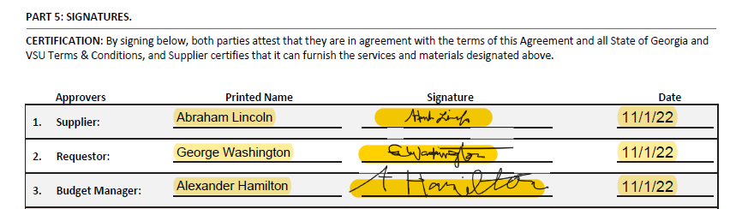
Part 5 of the msa form
Obtain the necessary signatures for the supplier (Abraham Lincoln), the requestor (George Washington), and the Budget Manager (Alexander Hamilton). The same person cannot sign as both the requestor and the budget manager, and the budget manager listed on the MSA must be the same budget manager listed on the DOS.

Slide 13
Once all steps have been completed
You will then submit both forms to HR through the independent contractor alias e-mail vsuindependentcontractor@valdosta.edu as pdf attachments (NOT through DocuSign).
Forms MUST be submitted a minimum of 30 days before the contractor is scheduled to work in order to allow enough time for a background check if needed and for processing. This is a requirement for all independent contractors.
Once received, HR will initiate a background check if needed with our vendor, Accurate. Please assist by working with your independent contractor to remind them to check their email and respond to Accurate’s request for consent to perform a background check.
After HR has approved the independent contractor, you will then receive an e-mail stating that you may now log in and submit your ePro request. Please make sure that the supplier signs the agreement, and a PO is established prior to services being rendered.
Please note that a contractor CANNOT WORK unless ALL the following are completed:
  ⎕ A successful background check has been completed (if needed)
  ⎕ HR has approved the independent contractor
  ⎕ The supplier has signed the MSA
  ⎕ A Purchase Order is established

