Slide 1
Faculty Success Survey Report
The Faculty Success Council’s Faculty Success Survey, distributed in Spring Semester 2022, asked VSU faculty to offer their definitions of faculty success and to identify faculty development opportunities and other means of faculty support.
This questionnaire sought to gather impressions of the current state of faculty success at VSU rather than to present a scientific assessment of this issue. The 111 responses to this Qualtrics survey represent a snapshot of a range of faculty viewpoints of faculty success at VSU.

Slide 2
Faculty Success Survey
The following slides show the summaries of the answers to open-ended questions by the FSC subcommittee that reviewed the total responses:
  Anita Davis, Katherine Adams, Adam Wood, Emily Rogers, Kate Warner, and Deborah Paine.
The concluding slides offer starting points for further discussion of the survey feedback and identifies the FSC representatives.

Slide 3
Faculty Success Survey Questions
Faculty success is multi-dimensional and does not look the same for each faculty member. However, an over-arching definition can provide direction and help us refine our goals. Given this, what are some key indicators you believe should be included in VSU’s definition of faculty success?
If VSU were to implement a faculty development model that would help you make progress towards faculty success as you define it, what developmental opportunities do you think the model should include? What content or topics should be included?
What kinds of trainings or professional development activities work best for you? Please select all that apply.
What type of support do you need to foster faculty success, as you define it?
Please let us know any additional thoughts about your ideal model of faculty success.

Slide 4
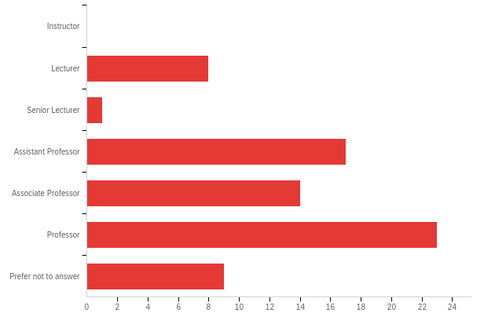
What is your faculty rank at VSU? (Optional)

Slide 5
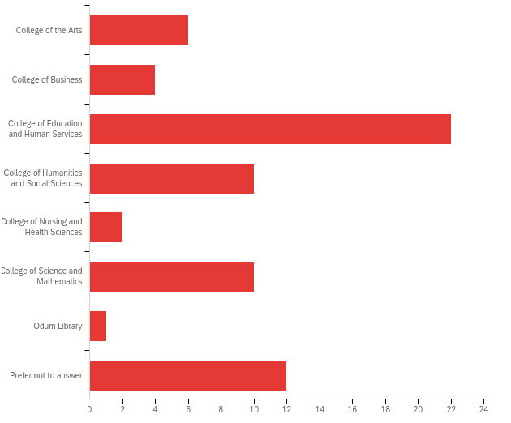
In which college or unit is your main faculty assignment? (Optional)

Slide 6
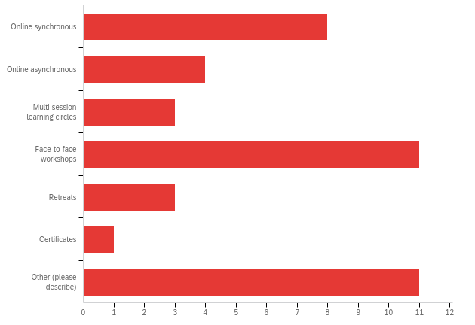
What kinds of trainings or professional development activities work best for you?

Slide 7
Dr. Davis
The complexity of faculty talents and intellect dictates the need to recognize and challenge homogenous systems of faculty employment, support, and evaluation.
This survey indicates that support and evaluation processes often fail to bring about faculty success and work life satisfaction.
This survey also indicates failure to address the assets and desires of students, our primary constituents, who invest in our institution expecting new career and life satisfying opportunities.

Slide 8
Dr. Adams
Faculty success means…
Excellence and fulfillment in the areas of teaching, scholarship, and service
An overall sense of well - being / work-life balance
A sense of team work and morale in the workplace
Feeling appreciated and valued by colleagues and administrators
Faculty success is supported by….
Convenient professional development opportunities
Sufficient time and resources to meet the needs of one’s job responsibilities
Access to practical/instrumental support for tenure and promotions
Fostering connections over administrative tasks
Collaboration with others
Receiving mentorship at all levels of career (early and mid-career)
Receiving comparable pay and funding
Receiving formative and meaningful feedback to contribute to growth and development

Slide 9
Dr. Wood
Implications:
Small scale faculty socials with beer/wine/snacks provided—this idea emerges out of repeated comments about seeking a greater sense of community and sense of belonging or, as one commenter put it, a desire to be “members of a fellowship of scholars.” Note that “Community” was mentioned 19 times and “Connection” was mentioned 14 times.
Faculty mentorship either by discipline or by other choice for junior faculty. “Mentor” was mentioned 25 times.
Mentorship of tenured faculty by administrators to promote leadership potential and professional advancement. Again, “Mentor” was mentioned 25 times.
Increased research/travel funding and/or grant writing workshops. “Funding” was mentioned 25 times.
More humane expectations for research given the high teaching loads and service expectations or, perhaps, workshops that might help faculty develop their research. This one is trickier to quantify as different faculty spoke to it in different ways, but there was a recurring theme of needing more time for scholarly pursuits. I think this also goes to “Time” which was mentioned 90 times, though in various ways.

Slide 10
Ms. Rogers
Determining Faculty Success
Many responses express desire for personal and professional growth as a major component of faculty success:
  Desire for connection and strong relationships with other faculty, within VSU.
  Feeling you can make a difference
  Contributions to significant publications and national organizations
  Autonomy and agency in work, university culture, “being seen” on campus
  Need for positive, constructive feedback from above.
  Healthy work/life balance

Slide 11
Ms. Rogers
Support Needed for Faculty Success
Possible Administrative interventions:
  Need for time and other resources (funding, equipment) to be supportive of student development.
  Ability to fulfill the FEM expectations.
  Flexibility in faculty expectations—some for research, some for service, for example—rather than one-size-fits-all expectations for all faculty
  Clear, reasonable expectations for evaluations
  Better pay and funding opportunities
Possible Faculty Success Council interventions:
  Regular and small-group engagement with other faculty
  Mentoring
  Inclusiveness of all faculty, including non-TT faculty
  Examples for t&p materials
  Way/person to offer suggestions to for connections among faculty for research, social support—perhaps a BlazeVIEW shell?
Funding opportunities
Time to engage with students for student success, Fewer administrative tasks such as compliance training, APL, etc.
Lower student-to-faculty ratio, More faculty to share the workload
More staff support for administrative tasks that interrupt academic work, such as travel paperwork
Reduce amount of service duties for faculty
Good communication, More listening and less talk from the administration

Slide 12
Dr. Warner
What is Faculty Success:
No one size fits all
Student success and faculty success are two sides of the same coin
Feeling that there is a balance of teaching, scholarship, and service
Includes work/life balance
Feeling that one’s work is seen and valued by colleagues and administration

Slide 13
Dr. Warner
How we can we better support Faculty Success:
Faculty want more connection and communication with administration
Thriving relationships between faculty, students, and administration are indicators of faculty success
Fewer administrative duties, Time, & Work-Life Balance
Time constraints limit activities like professional development and research
Faculty are looking for leadership opportunities
Increase the Quality of Relationships and Sense of Belonging
Faculty are Looking for Connection and Community
Need for Mentor/Mentoring
Mentors for both faculty and students is central to faculty success

Slide 14
Dr. Paine
Themes that are “in our purview” and “outside of our purview.” My lens is product-driven, or maybe, movement forward.
Themes I found we can influence:
Not a one size fits all definition of success
Supporting student relationships
Time
Mentoring of faculty (peer evaluations)
Work-Life Balance
Creating a sense of belonging
Themes we cannot influence:
Pay and additional resources provided by the university
Time
Work-Life Balance

Slide 15
Discussion:
Implications for the Faculty Success Council
How to improve connections and a sense of belonging
  Faculty/Student
  Faculty/Faculty
  Faculty/Administration
How to improve mentorship of faculty
How to improve communication
Use of Time & Work-life Balance
Recognizing Uniqueness: Getting rid of one size fits all

Slide 16
Faculty Success Council Membership
The Faculty Success Council is made up of two members from each college, one from the Center for Excellence in Learning and Teaching (CELT) Board, and one selected by the college’s executive leadership. There are additional members from other campus constituencies such as the Department Heads’ Council, Advisors, and more.
The 2021-2022 FSC membership is available here: https://www.valdosta.edu/academics/academic-affairs/faculty-success-council/council-members.php
Please contact your college representatives for more information about or to offer feedback on this survey.

